Slide 1
Demarcating Crime Regions in Urban Areas using Gaussian Mixture Models
By: Japneet s. kohli
Class: Ait 690 002 smart cities and urban computing
Semester: Spring 2020
Instructor: dr. mahdi hashemi

Slide 2
Agenda
Introduction
Related Works
Data Description
Methodology
Results
Conclusions

Slide 3
Introduction
Scope of Project:
Study of crime data in New York city to identify crime regions
Context:
Cities release lot of data publicly
New York releases crime complaint datasets
Based on analysis of crime data, implement algorithms to find crime regions
Two algorithms implemented – supervised (classification) and unsupervised (clustering) using Gaussian mixture models (GMM)
For supervised algorithm, violence labels are heuristically created to be classified
For unsupervised algorithm, interesting patterns or types of data are used

Slide 4
Related Works
GMM Definition
Probabilistic model that assumes that all the data points in it are generated from a mixture of a finite number of Gaussian distributions with unknown parameters
Fiez and Ratliff Case Study
Identify curbside parking demand using GMM clustering
Qi, Li, Wang, and Liu Study
Tri-layer circle memory based GMM created to enhance memory storage capabilities of systems

Slide 5
Related Works
Fan, Huang, and Diao Study
Using GMM-based Kalman filters to provide parameter selections with better accuracy for dynamic machine learning models
Hsu, Lian, and Huang
Identify characteristics in highway traffic dynamics using hierarchical GMM in combination with traffic phase-transition analysis
Yu, Yang, and Chan
Simplifying GMM by reducing number of mixture components accomplished by maximizing lower bound of log-likelihood

Slide 6
Related Works
Subramani, Michalska, Wang, Du, Zhang, and Shakeel
Multi-class identification of domestic violence using social media and deep learning (CNN, RNN, LSTM,GRU, Bi-LSTM)
Ramzan, Abid, Khan, Awan, Ismail, Ilyas, Mahmood
Critical review of techniques and methods used for identifying violence
Quality of datasets limits quality of analysis key takeaway

Slide 7
Data Description
Dataset: New York Police Department Complaint Map for 2019
Source: New York City’s Open Data Portal
Size: 461,711 Records, 24 Attributes
Attribute Types
Start and end date and time of complaint
Type of crime (various granularities) with descriptions
Precise geolocation data (coordinates)
General location data (boroughs, address precinct code, etc.)

Slide 8
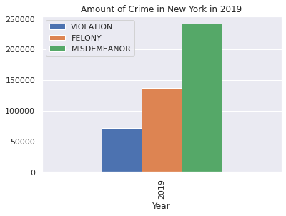
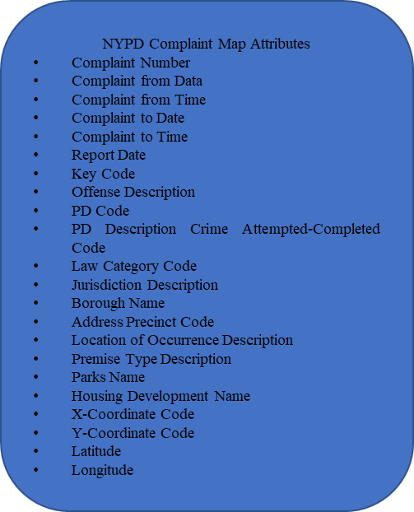
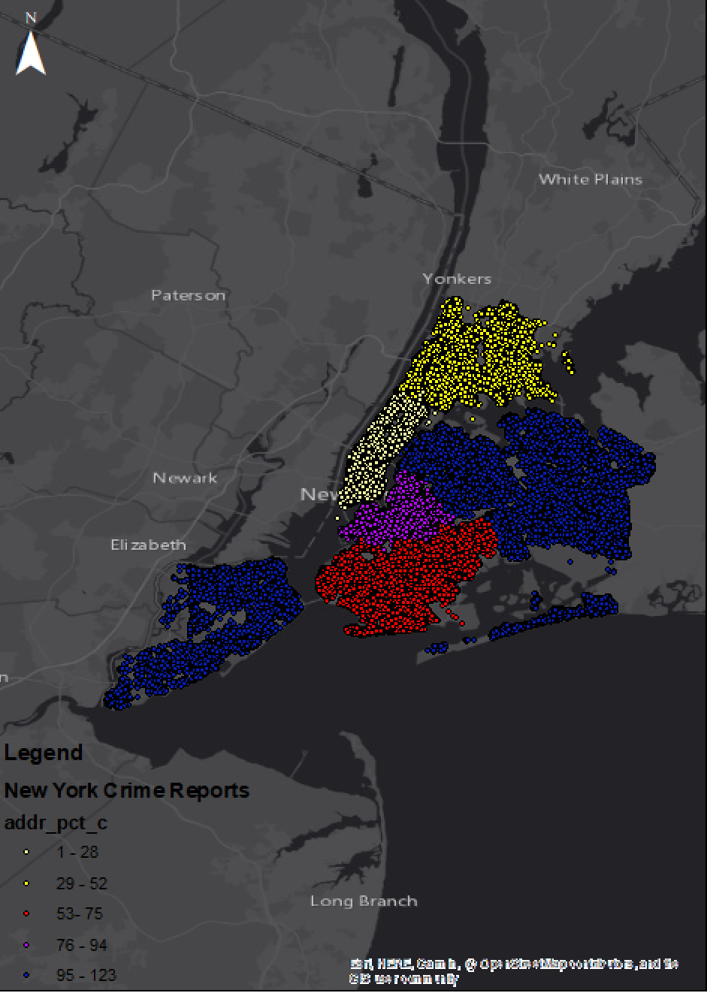
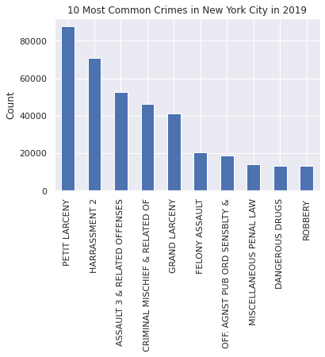
Data Description
Crime Frequency by Law Category
New York City Crime Reports by Precinct Code
List of Attributes in Dataset
Top 10 Crimes

Slide 9
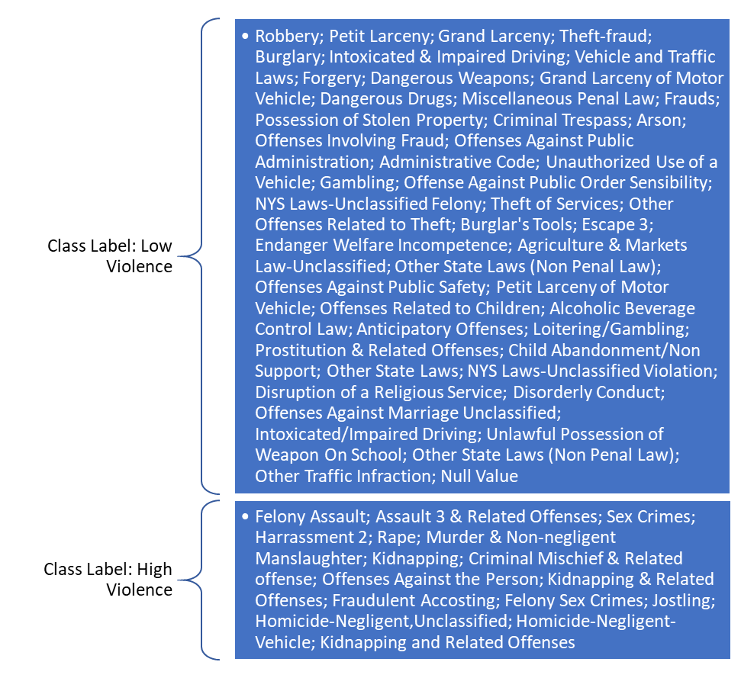
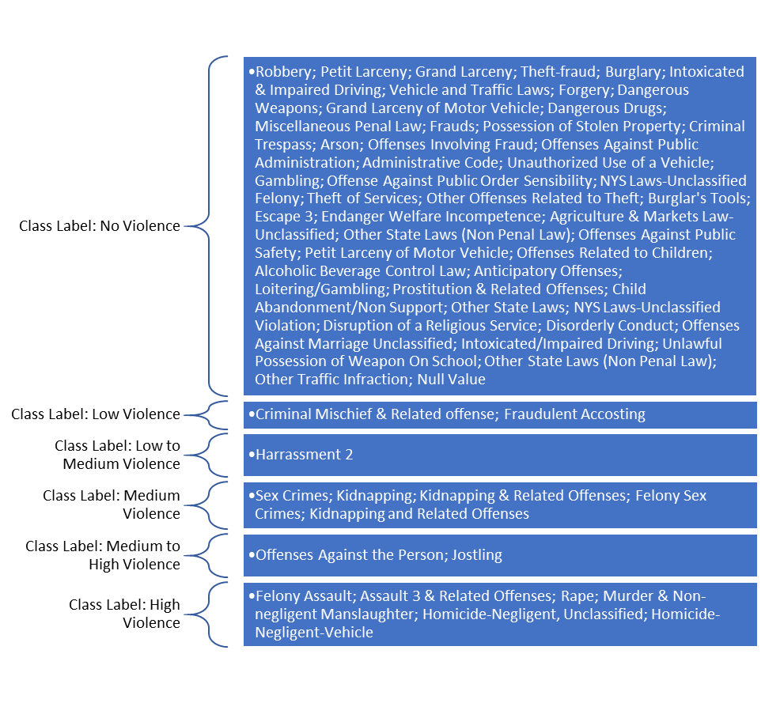
Methodology
Supervised Learning Approach
GMM-based algorithm predicts class of violence
STEP I: Violence Class Determination
Heuristic method using Offense Descriptions to classify
2 sets of violence identified
Binary (High/Low Violence)
Multi-class (No/Low/Low-Med/Med/Med-High/High Violence)
Set I class labels based on offense description
Set II class labels based on offense description

Slide 10

Methodology
GMM Equation
Supervised Learning Approach
GMM-based algorithm predicts class of violence
STEP II: GMM Algorithm
GMM is a weighted sum of densities of various Gaussian components within continuous data vectors
Parameters for GMM
$w_{i}$ = weight, x = data, $µ$ = mean, $Σ$ = covariance matrix, $λ$ = parameter set, M = number of mixtures

Slide 11
Methodology
GMM Attributes | Model 1 | Model 2 | Model3
Class Labels Set | Set II | Set I | Set I
Number of Features | 1066 | 1066 | 436
Train/Test Split | 80/20 | 80/20 | 80/20
Number of Mixture Components | 6 | 2 | 2
Max EM Iterations | 100 | 100 | 100
Number of Initializations | 1 | 1 | 1
Initialization Method | kmeans | kmeans | kmeans
Covariance Type | Full | Full | Full
Supervised Learning Approach
GMM-based algorithm predicts class of violence
STEP II: GMM Algorithm
GMM can only take numerical data
Convert categorical data to one-hot vectors
GMM Attributes Across Models for Violence Prediction

Slide 12
Methodology
Supervised Learning Approach
GMM-based algorithm predicts class of violence
STEP III: Visualize Predictions
Overlay predictions on map of NY to assess crime region demarcation

Slide 13
Methodology
Unsupervised Learning Approach
GMM-based algorithm using interesting crime patterns
STEP I: Find Interesting Crime Patterns or Categories
Data exploration to find such patterns employed
For interesting patterns, data filtered out to be trained over algorithm

Slide 14
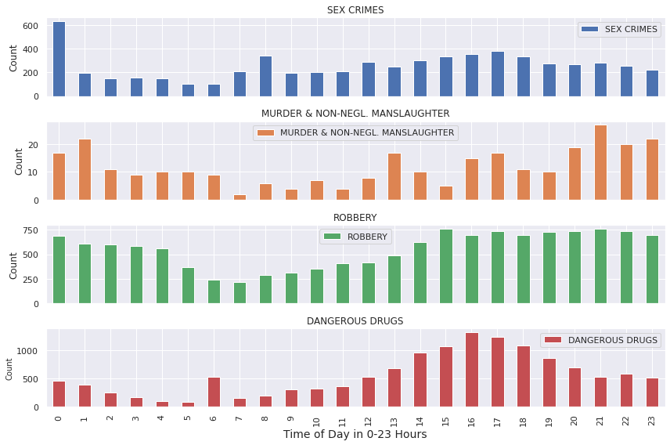
Methodology
Unsupervised Learning Approach
GMM-based algorithm using interesting crime patterns
STEP I: Find Interesting Crime Patterns or Categories
Sex crimes at midnight
Murder & non-negligent manslaughter between 9 pm and 2 am
Drug crimes at 6 am (anomaly)
Marijuana crimes
Drug sale crimes
Hourly Frequencies for Chosen Crimes

Slide 15
Methodology
Unsupervised Learning Approach
GMM-based algorithm using interesting crime patterns
STEP I: Find Interesting Crime Patterns or Categories
Sex crimes at midnight
Murder & non-negligent manslaughter between 9 pm and 2 am
Drug crimes at 6 am (anomaly)
Marijuana crimes
Drug sale crimes
Dataset Criteria | Number of Records
Sex Crimes at Midnight | 632
Murder & Non-Negligent Manslaughter Crimes between 9 pm and 2 am | 108
Dangerous Drug Crimes at 6 am | 533
Marijuana Crimes | 1,838
Drug Sale Crimes | 2,333
Criteria for interesting datasets

Slide 16

Methodology
GMM Attributes Across Models for Violence Prediction
GMM Attributes | Values
Max Number of Mixture Components | 100
Max EM Iterations | 100
Number of Initializations | 1
Initialization Method | kmeans
Covariance Type | Full
Training Features | Latitude, Longitude
Unsupervised Learning Approach
GMM-based algorithm using interesting crime patterns
STEP II: Train GMM
Model trained over location data only
Mixture components parameterized to iterate over 1 through 100 to find best model fit parameters
Akaike information criterion and Bayesian information criterion used for determining best fit
k = number of parameters in model, L = max likelihood after 100 expectation maximization iterations

Slide 17
Methodology
Unsupervised Learning Approach
GMM-based algorithm using interesting crime patterns
STEP III: Visualize GMM Output and Best Fit Models
AIC/BIC for each model visualized to observe “elbow” method
Best fit models visualized and compared to get best crime region demarcations

Slide 18
Results
Supervised Learning Approach
GMM-based algorithm predicts class of violence
Low Accuracies Observed
Evaluation Criteria | Model 1 | Model 2 | Model 3
Accuracy | 0.18 | 0.50 | 0.36
Log-Likelihood Score | 5052.50 | 4448.48 | 1879.26
Evaluation of GMM used for Violence Classification

Slide 19
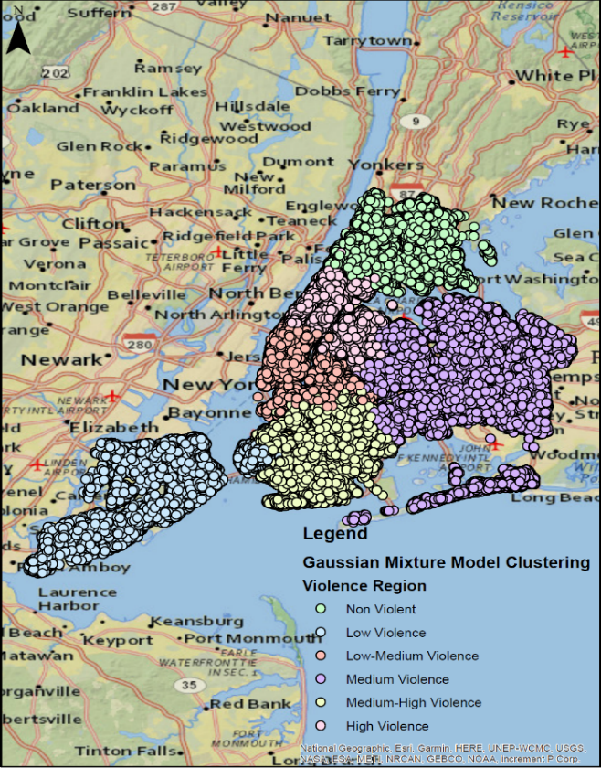
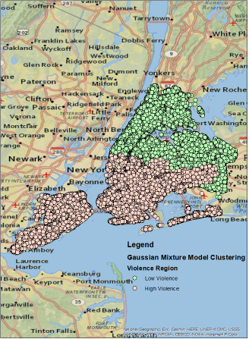
Results
Violence Regions in New York Based on Model 1
Violence Regions in New York Based on Model 2
Supervised Learning Approach
GMM-based algorithm predicts class of violence
Models 1 and 2 do Good Job of Learning Spatial Features

Slide 20
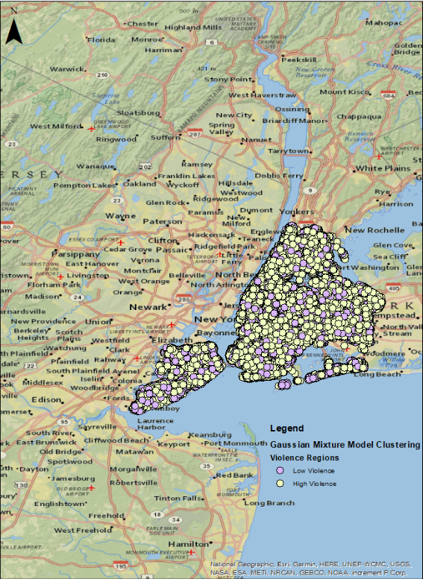
Results
Violence Regions in New York Based on Model 3
Supervised Learning Approach
GMM-based algorithm predicts class of violence
Model 3 was not provided Spatial Features
Violence Regions are predicted without Spatial Clustering

Slide 21
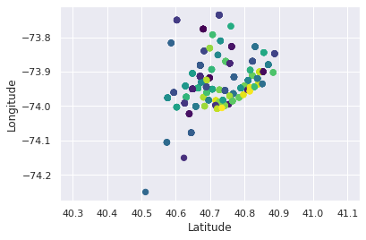
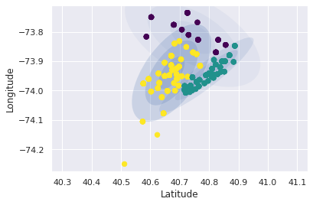
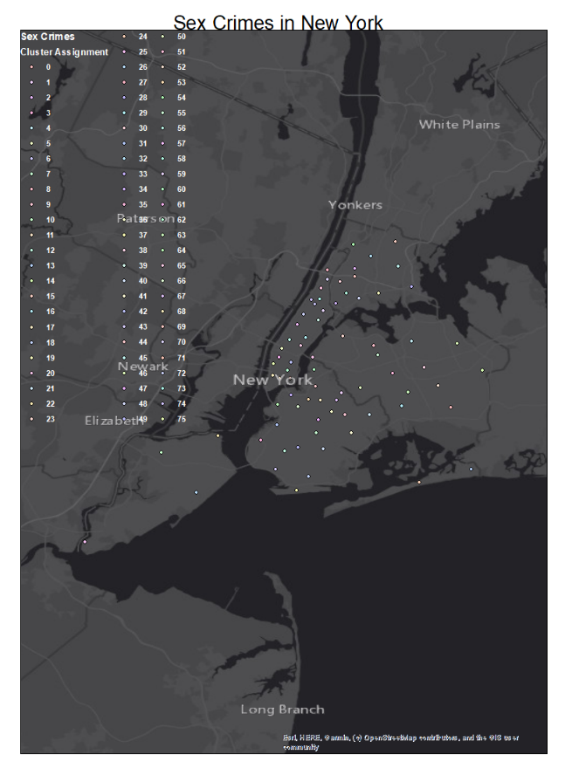
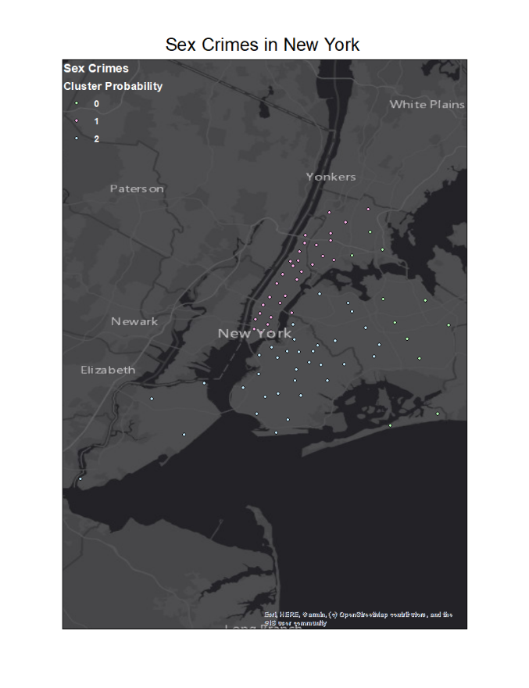
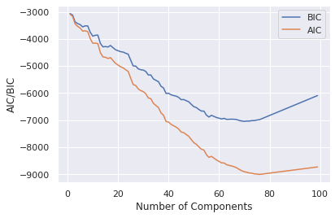
Results
Clustering Shown with Ellipses
Unsupervised Learning Approach
GMM-based algorithm using interesting crime patterns
Sex Crimes Dataset Results
Cluster Points Shown on Map of New York
AIC/BIC Scores

Slide 22
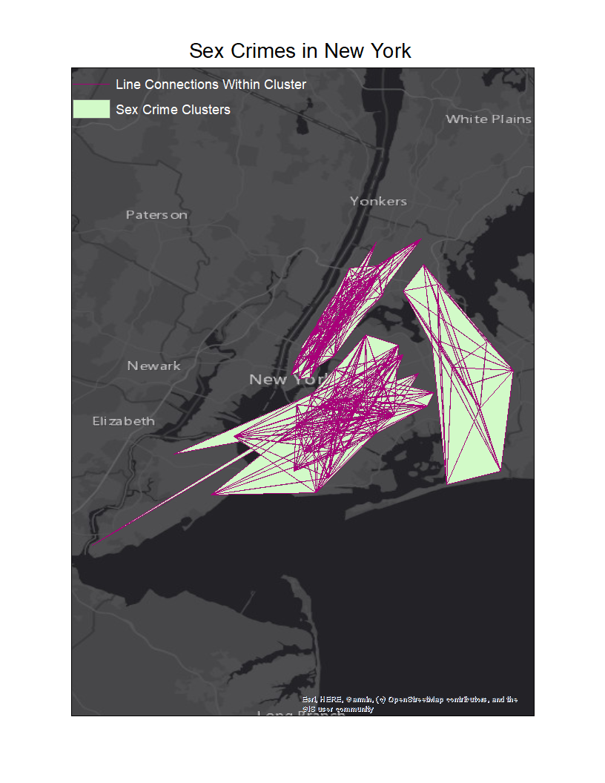
Results
Cluster Shapes Identify Crime Regions in New York
Unsupervised Learning Approach
GMM-based algorithm using interesting crime patterns
Sex Crimes Dataset Results

Slide 23
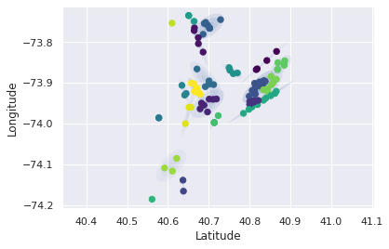
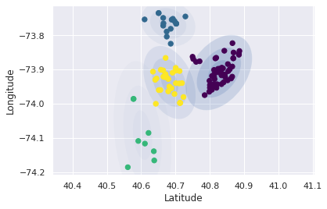
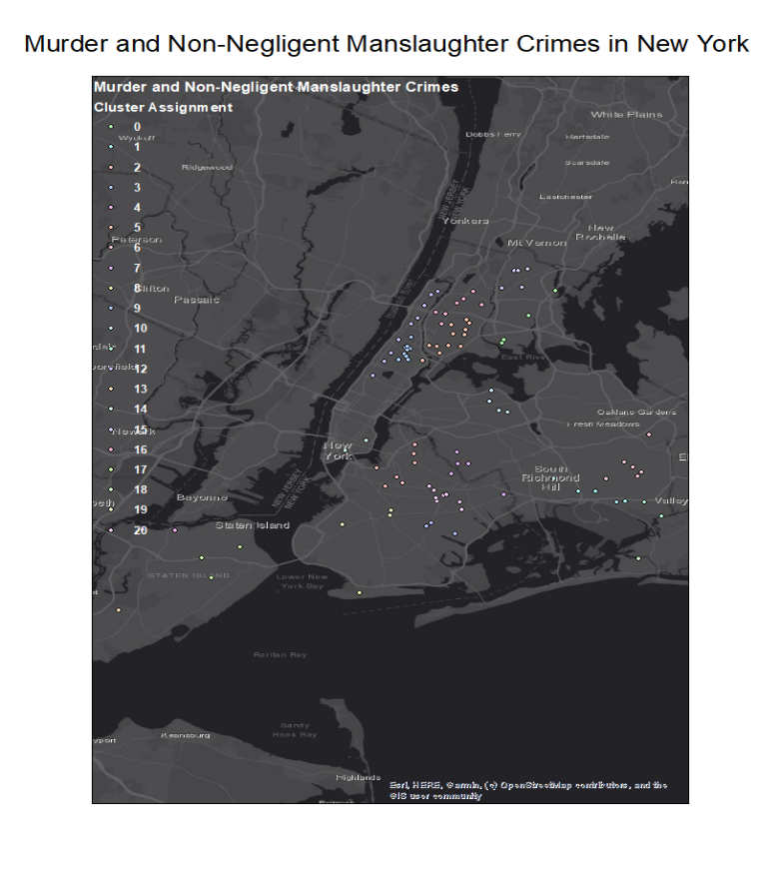
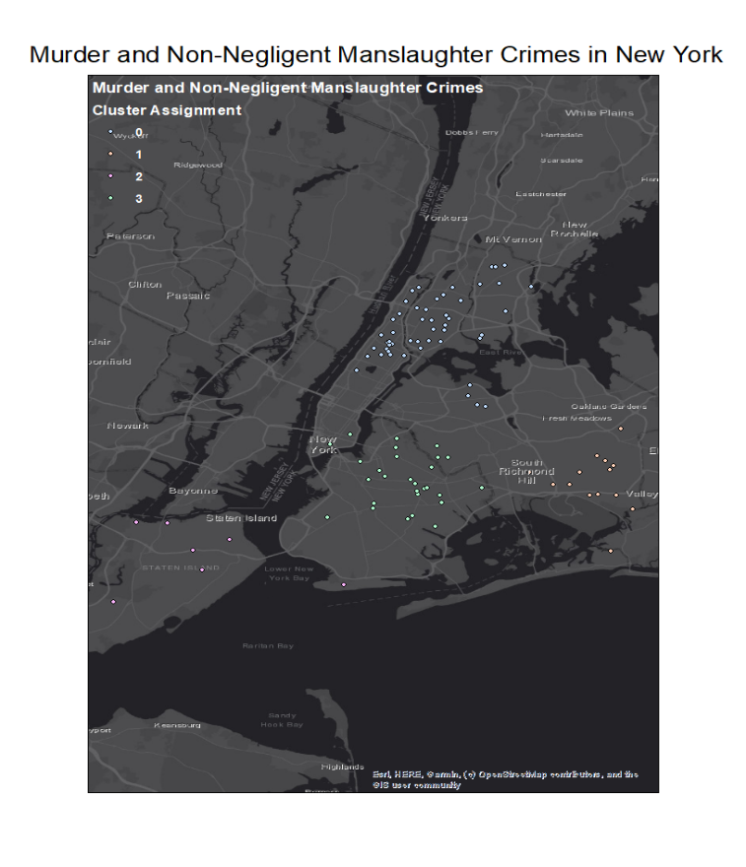
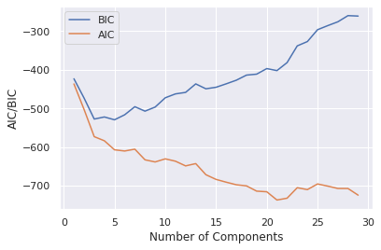
Results
Clustering Shown with Ellipses
Unsupervised Learning Approach
GMM-based algorithm using interesting crime patterns
Murder & Non-Negligent Manslaughter Crimes Dataset Results
Cluster Points Shown on Map of New York
AIC/BIC Scores

Slide 24
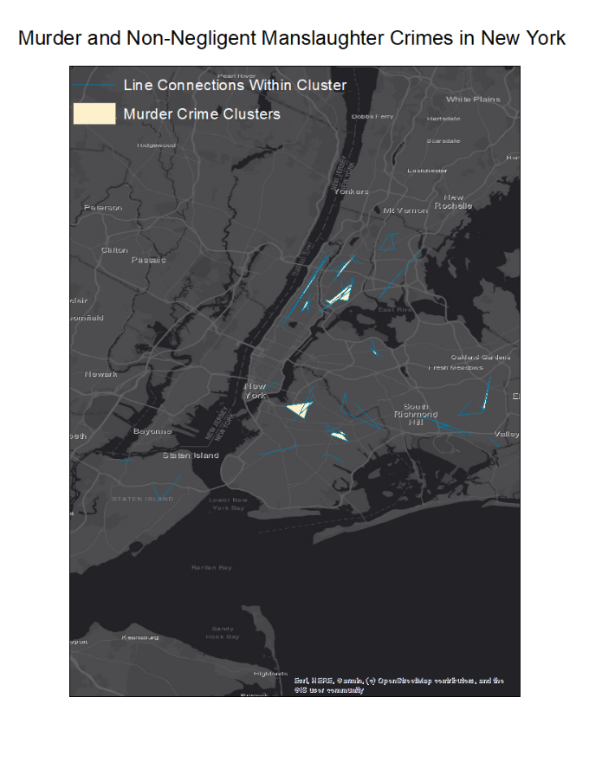
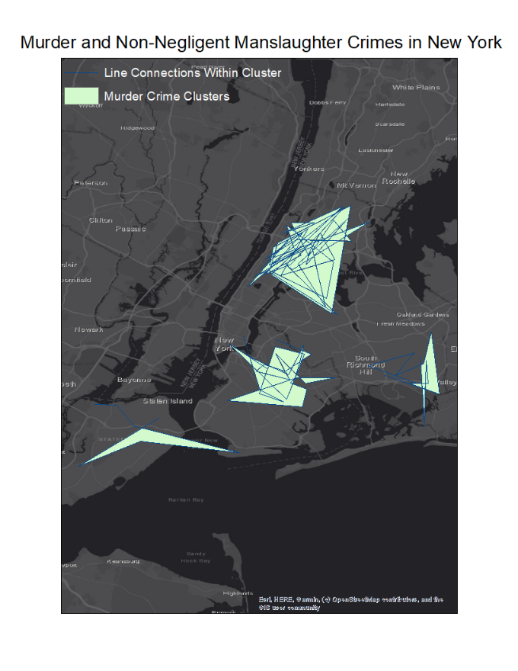
Results
Cluster Shapes Identify Crime Regions in New York
Unsupervised Learning Approach
GMM-based algorithm using interesting crime patterns
Murder & Non-Negligent Manslaughter Crimes Dataset Results

Slide 25
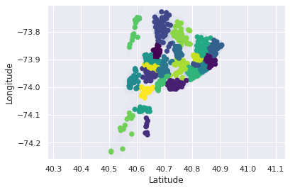
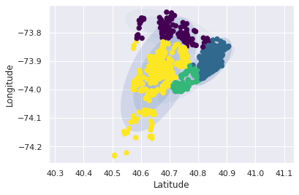
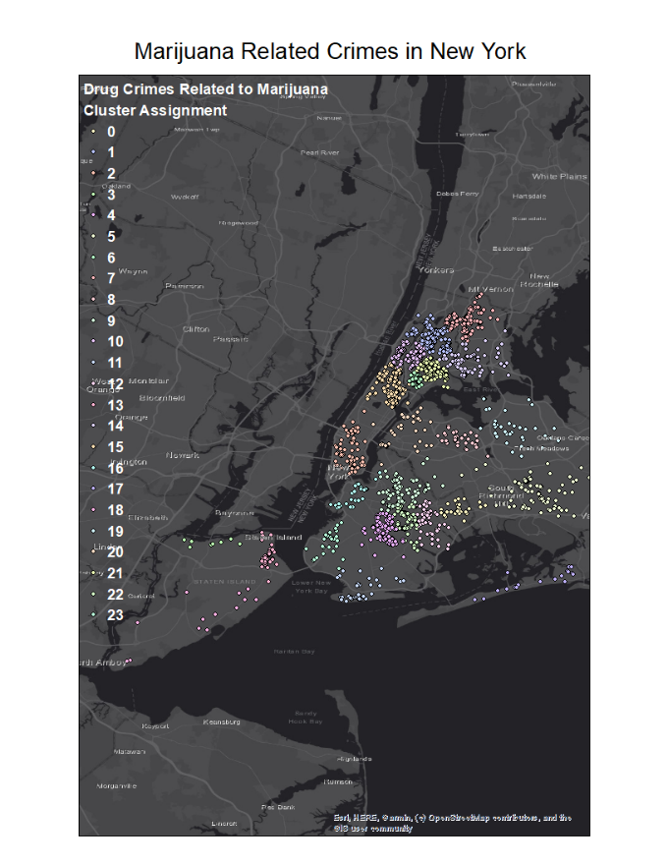
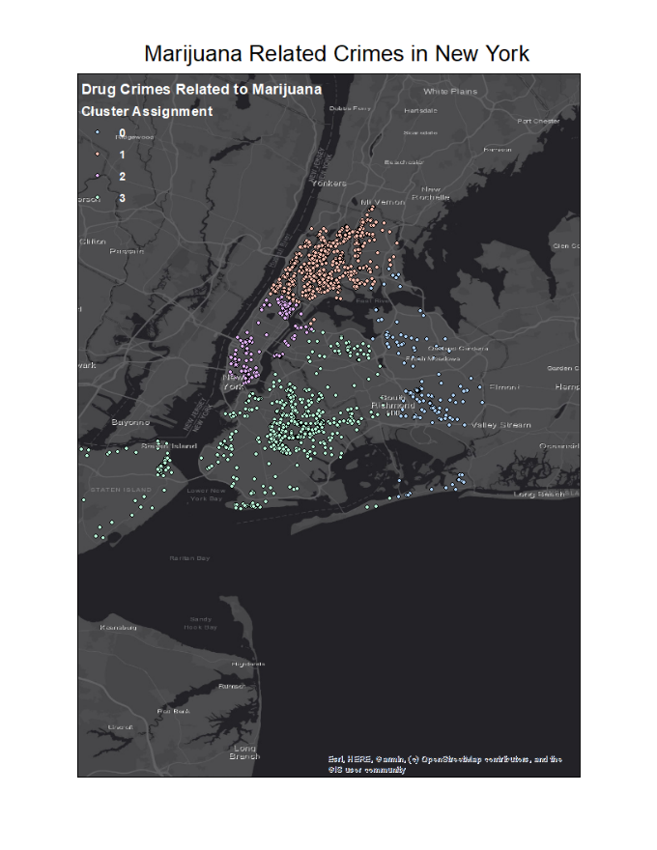
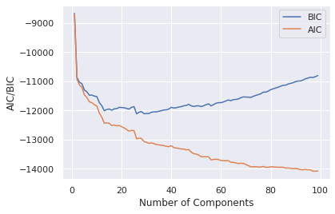
Results
Clustering Shown with Ellipses
Unsupervised Learning Approach
GMM-based algorithm using interesting crime patterns
Marijuana Related Crimes Dataset Results
Cluster Points Shown on Map of New York
AIC/BIC Scores

Slide 26
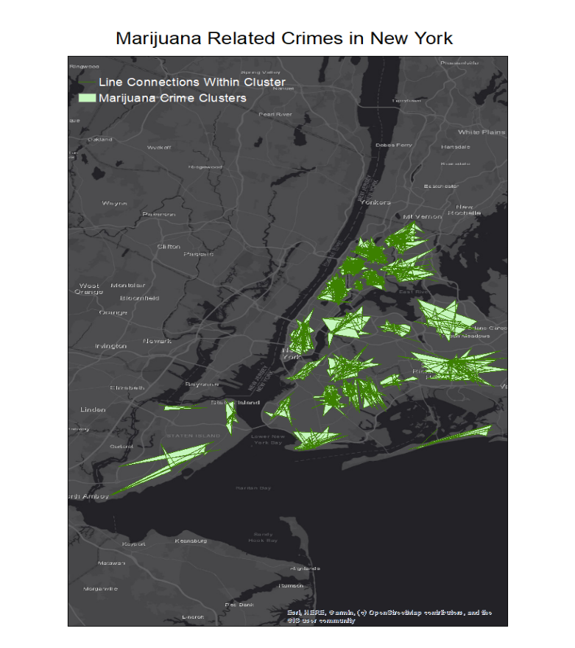
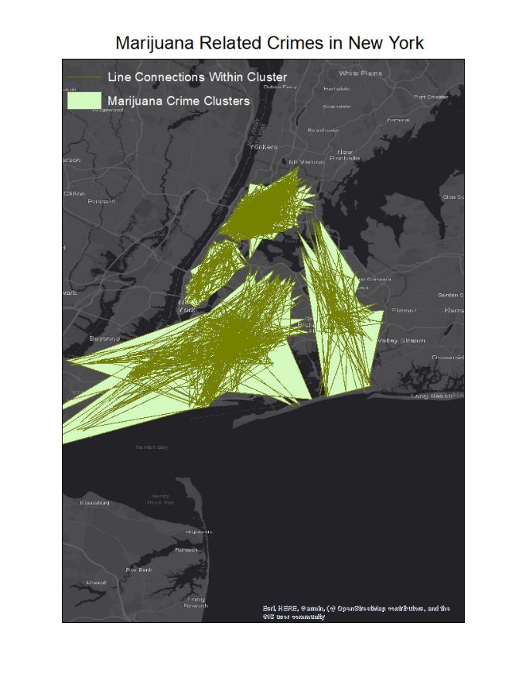
Results
Cluster Shapes Identify Crime Regions in New York
Unsupervised Learning Approach
GMM-based algorithm using interesting crime patterns
Marijuana Crimes Dataset Results

Slide 27
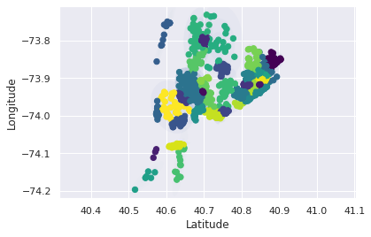
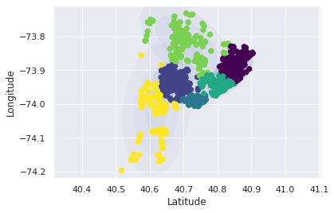
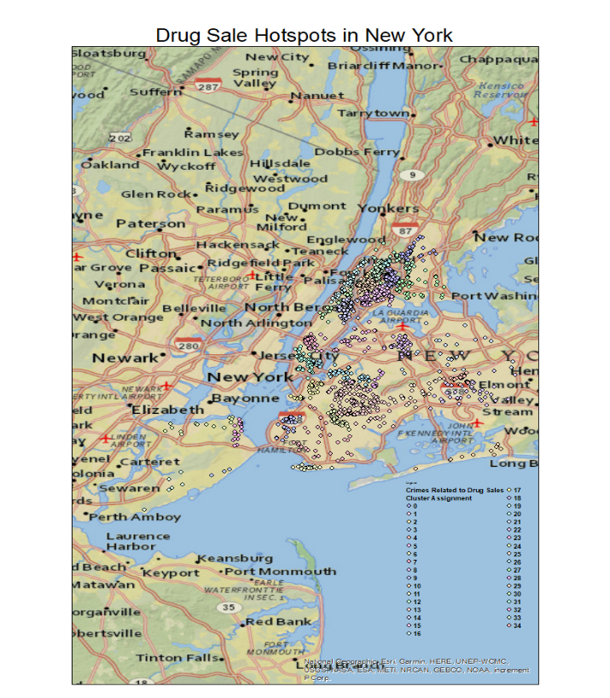
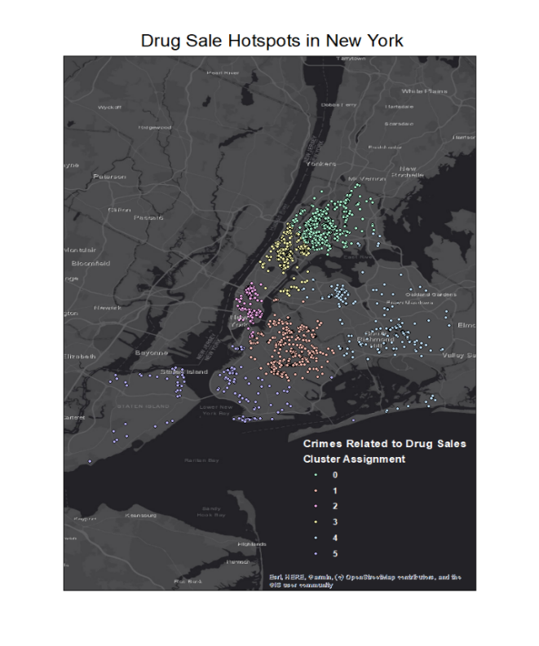
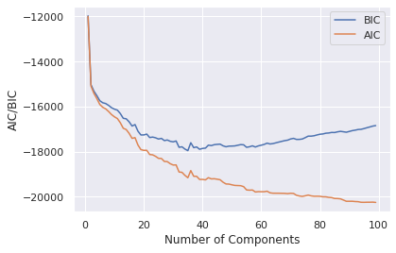
Results
Clustering Shown with Ellipses
Unsupervised Learning Approach
GMM-based algorithm using interesting crime patterns
Drug Sale Related Crimes Dataset Results
Cluster Points Shown on Map of New York
AIC/BIC Scores

Slide 28
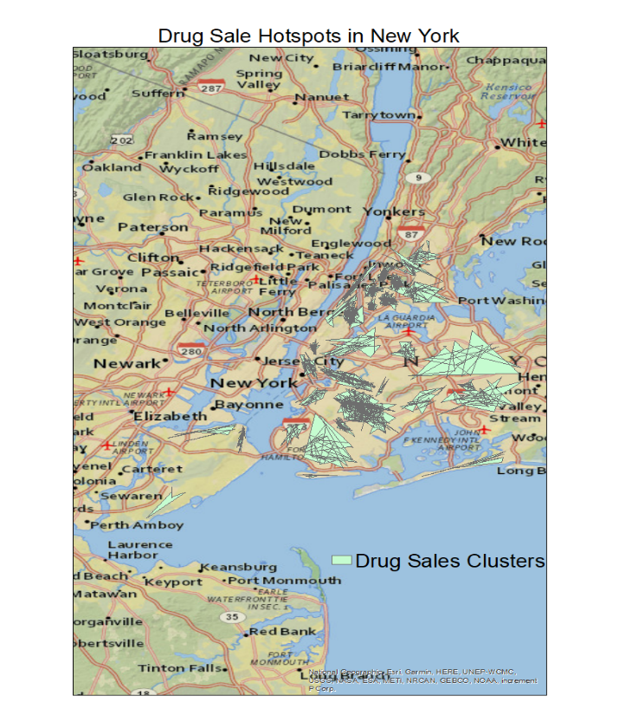
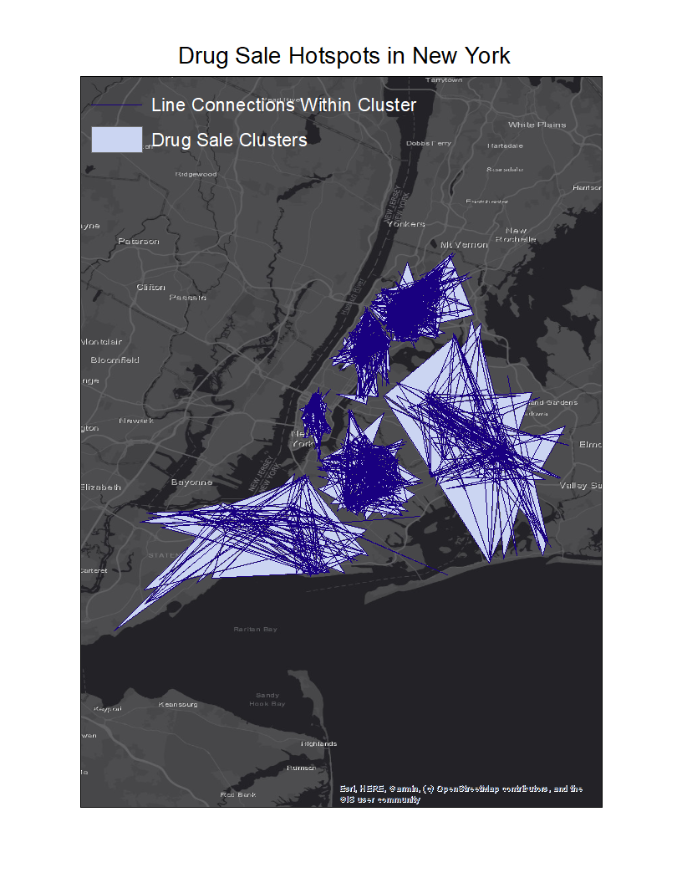
Results
Cluster Shapes Identify Crime Regions in New York
Unsupervised Learning Approach
GMM-based algorithm using interesting crime patterns
Drug Sale Related Crimes Dataset Results

Slide 29
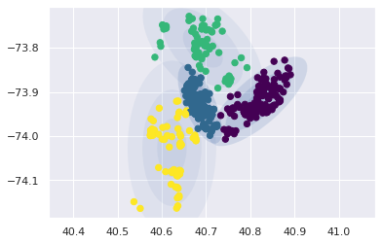
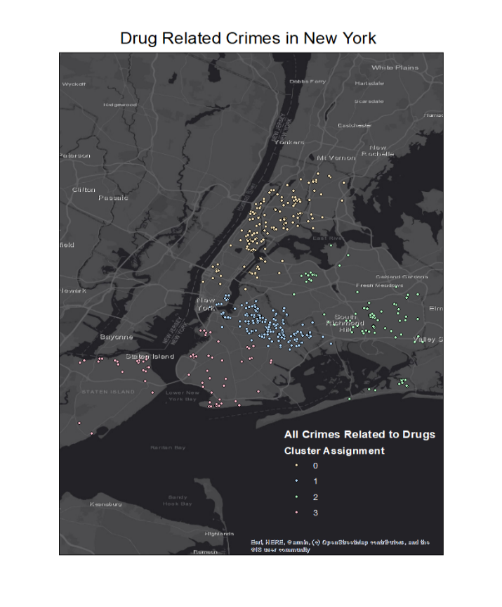
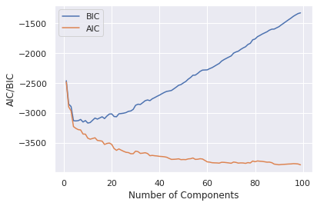
Results
Clustering Shown with Ellipses
Unsupervised Learning Approach
GMM-based algorithm using interesting crime patterns
Drug Related Crimes Dataset Results
Cluster Points Shown on Map of New York
AIC/BIC Scores

Slide 30
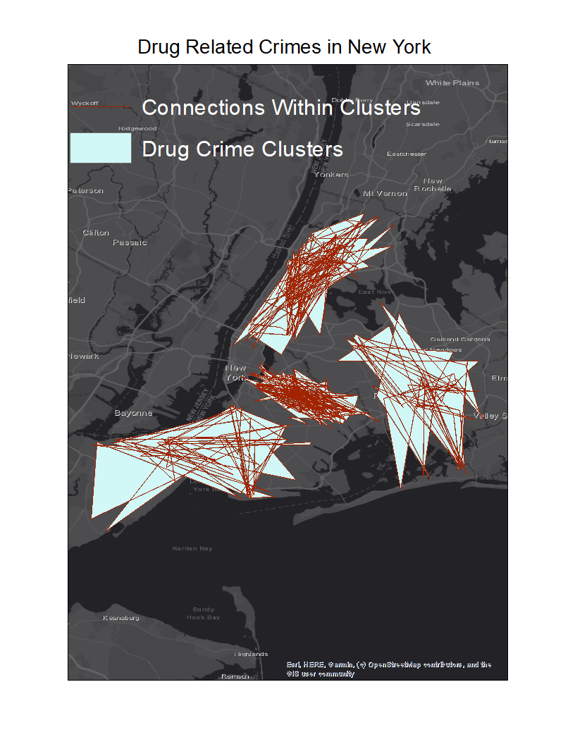
Results
Cluster Shapes Identify Crime Regions in New York
Unsupervised Learning Approach
GMM-based algorithm using interesting crime patterns
Drug Related Crimes Dataset Results

Slide 31
Conclusions
Crime region demarcation was performed with contrasting results from the two approaches
Supervised Learning GMM-based approach for classification of violence regions had mixed results
Low accuracies returned but spatial features were learned well
Shortcoming of model is how violence labels are determined
Spatial information was not tied to violence label determination
This could be considered for future research

Slide 32
Conclusions
Crime region demarcation was performed with contrasting results from the two approaches
Unsupervised Learning GMM-based approach for identifying regions of interesting crime patterns and types showed promise and reliable results
Exploration of data is required to find meaningful data to be analyzed through this algorithm
Endless possibilities of types of crimes that can be demarcated
Use of geolocation features to identify spatial clustering was successful in identifying hotspots of high frequency regions associated with certain types of crimes
This methodology can be applied to create useful visualization tools for public agencies

Slide 33
Thank You

